Slide 1

FLICKS AND FIGURES: A DATA DRIVEN DIVE INTO CINEMA
Data Warehouse and Pipelines - DATA226

Slide 2
Meet the
TEAM
Aayushi Shah (018180136)
Apurva Muchandi
(018205785)
Dhruva Joshi
(0181891576)
Rohit Dhole
(018195320)
Suyog Jadhav
(018222750)

Slide 3

INTRODUCTION
Movies are more than entertainment—they're cultural snapshots.
Stakeholders like filmmakers need real-time analytics to predict trends, understand audience preferences, and optimize movies performance.
Our project merges historical and real-time movie data for actionable insights.
Notes:
movies are more than entertainment, they are our cultural snapshots
stakeholders like filmmakers need real time data to predict trends, understans audience preferences to improve their movie perfomance

Slide 4
INTRODUCTION
Problem Statement:
Ever wondered why some movies captivate audiences while others flop? The answers are hidden in data—but it’s scattered across platforms like IMDb and TMDb, making it nearly impossible to connect the dots.
Without a unified view, stakeholders are left guessing about audience trends, genre preferences, and what truly drives box office hits.
Notes:
So lets think if we have so much data what is the issue with movie performances

Slide 5
INTRODUCTION
Solution:
To create a seamless, automated platform that integrates historical and real-time movie data to uncover actionable trends and insights.
Empower stakeholders with a live dashboard that turns data into decisions.

Slide 6




SNOWFLAKE
AIRFLOW
DBT
SUPERSET
Centralized, scalable data storage
Seamless automation of ETL pipeline
Clean, transform, and document data
Intuitive and interactive dashboards
TECHNOLOGY STACK

Slide 7
PROJECT OBJECTIVES
Analyze Trends and Patterns
Data trends help uncover audience preferences
Scalable analysis ensures insights evolve with new datasets.
Combine Historical and Real-Time Data
Integrating dynamic data sources strengthens the platform’s adaptability
Build a Scalable Analytics Platform

Slide 8
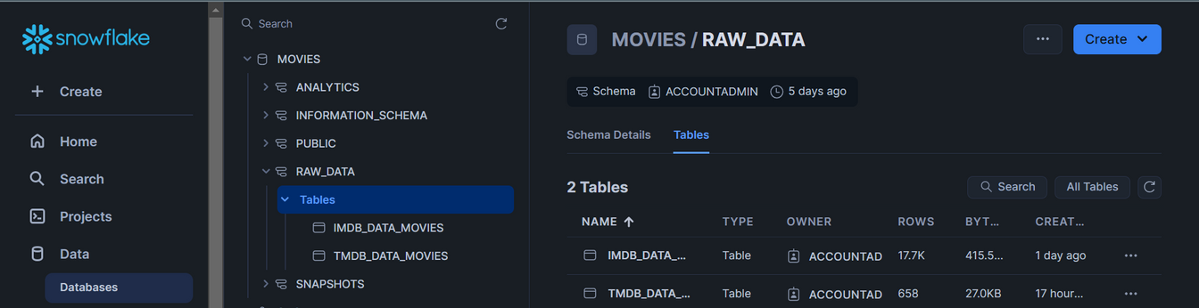
Understanding Data
DATASET DESCRIPTION
Historical Data:
Source: IMDb
Content: Title Type, Primary Title, Start Year, Genres
Use Case: Analyze long-term trends and benchmarks.
Real-Time Data:
Source: TMDb (The Movie Database)
Content: Movie ID, Title, Release Date, Popularity, Vote Count, Genres
Use Case: Immediate insights into current trends and audience behavior.

Slide 9
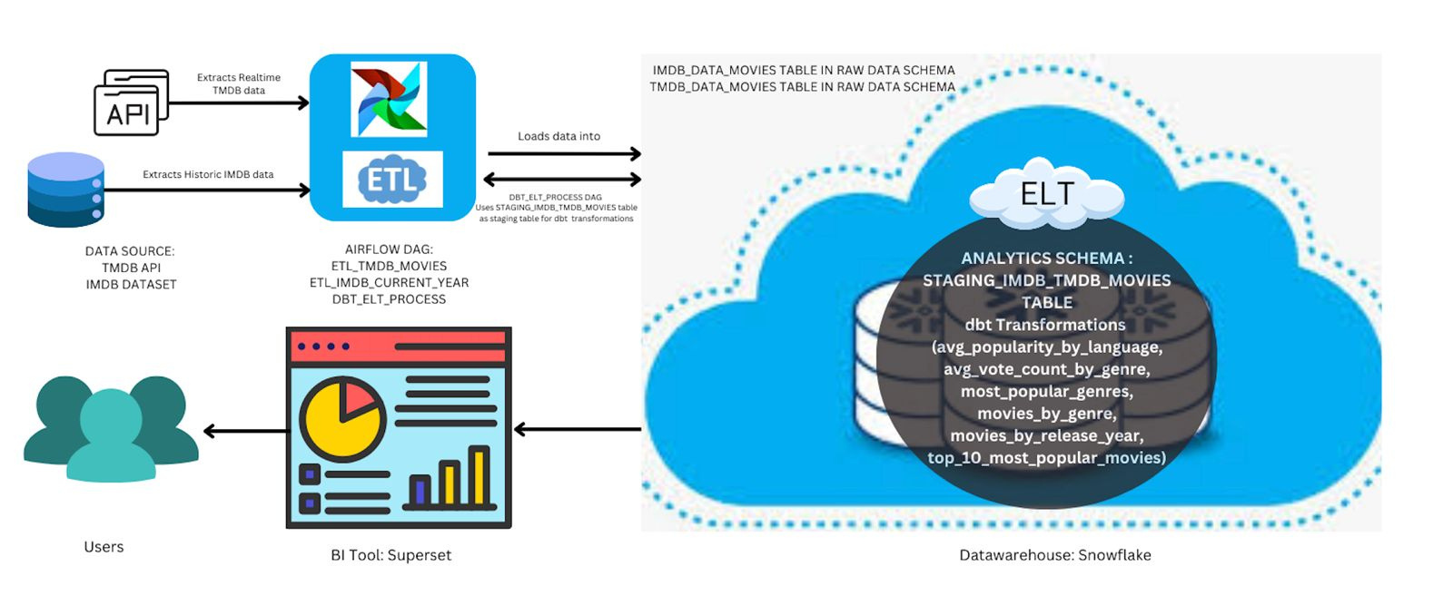
Understanding Data
SYSTEM ARCHITECTURE

Slide 10
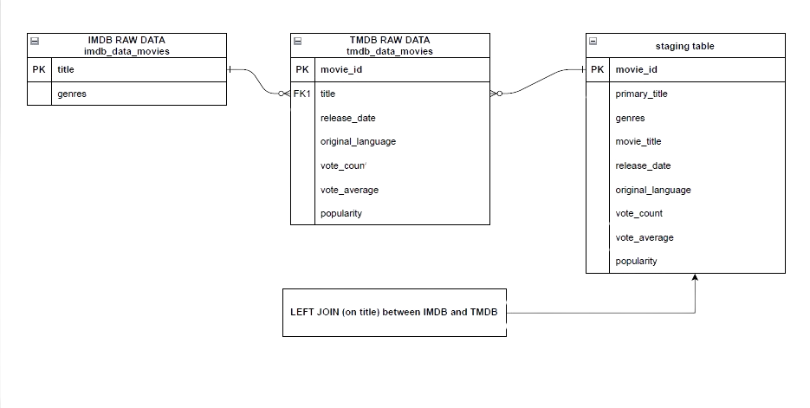
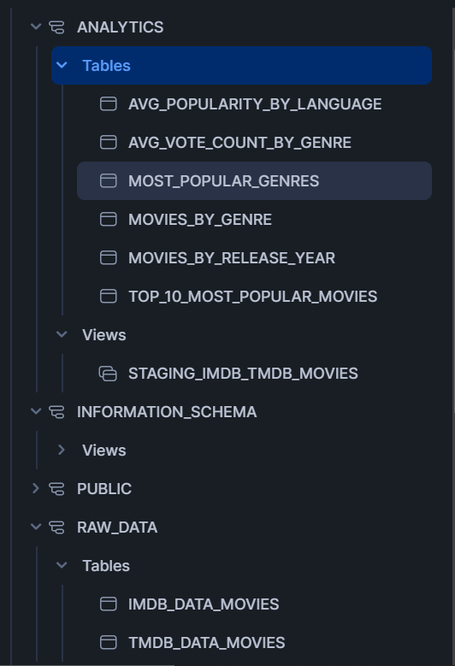
Understanding Data
DATABASE SCHEMA - ER DIAGRAM

Slide 11
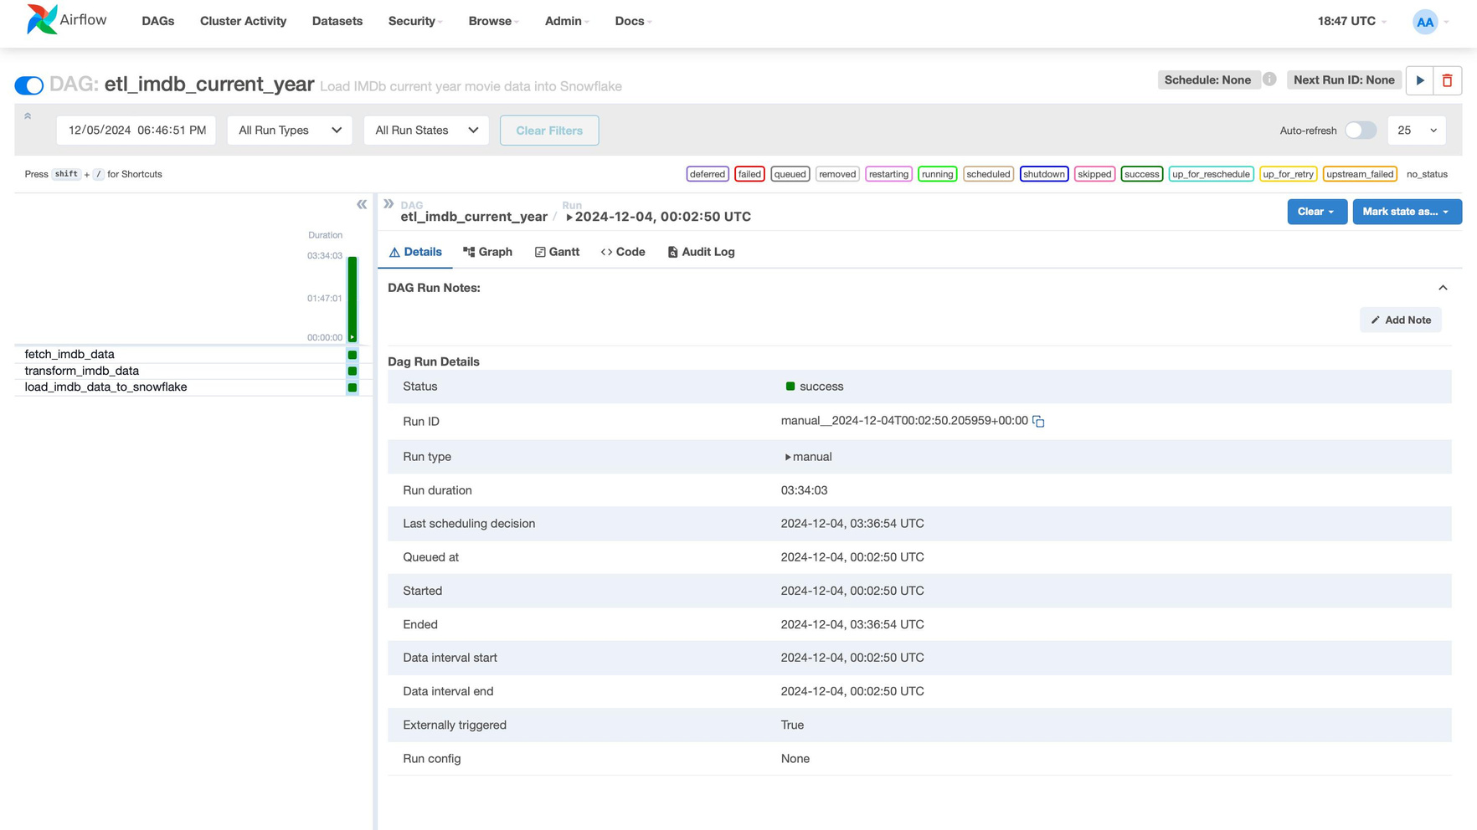
ETL/ELT PROCESS
Step 1 - Extract
Full Refresh
Triggered manually

Slide 12
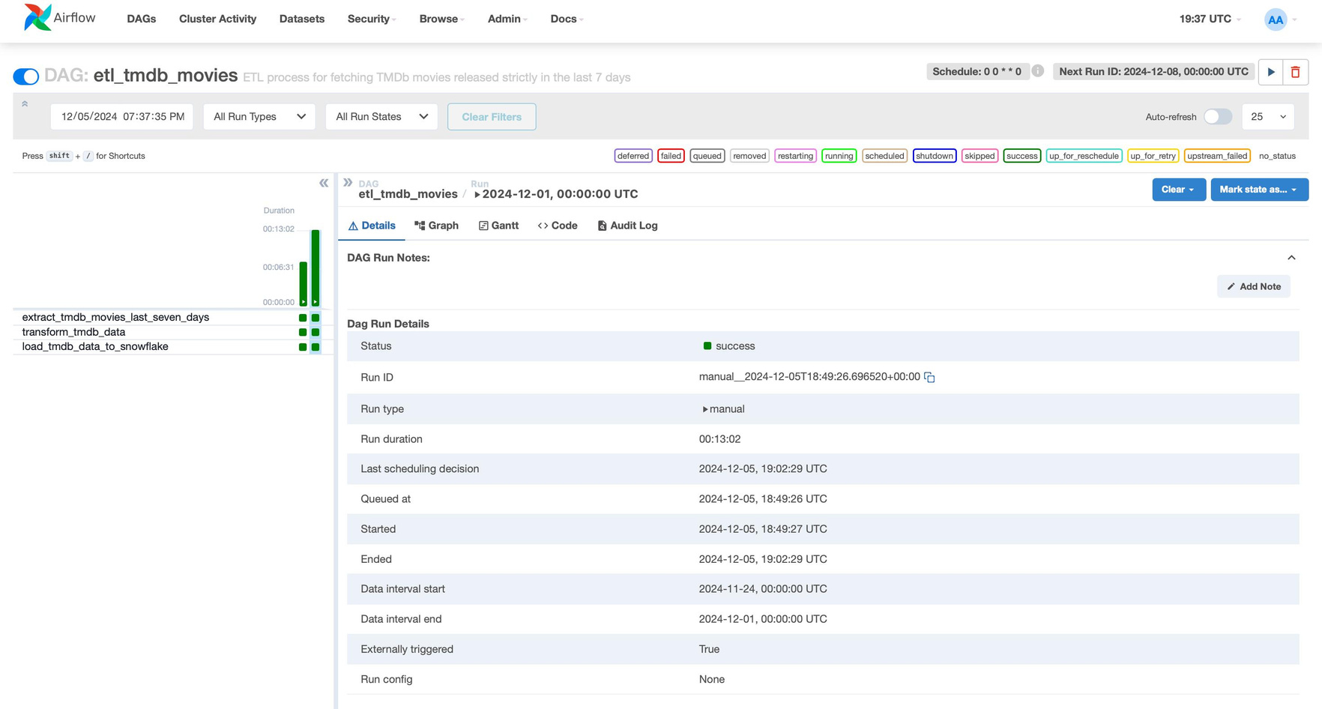
ETL/ELT PROCESS
Step 1 - Extract
Incremental Update
Runs every Sunday @12:00 am

Slide 13
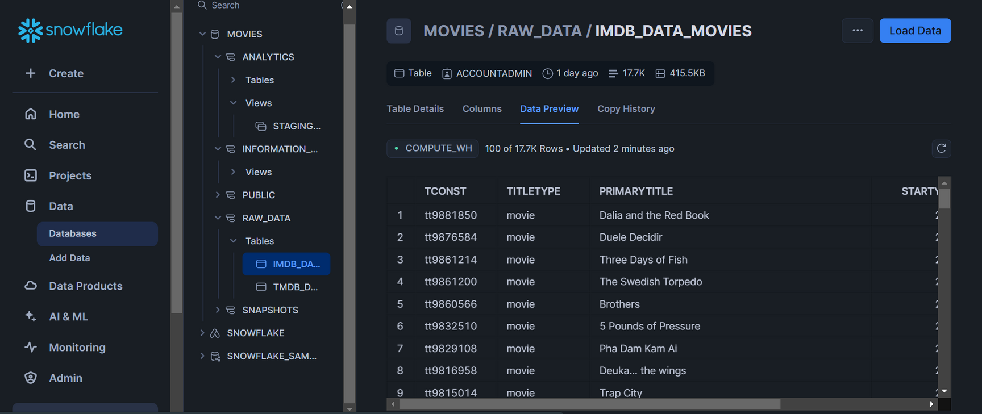
ETL/ELT PROCESS
Step 2 - Load
Load Raw Data from IMDb and TMDb directly into Snowflake

Slide 14
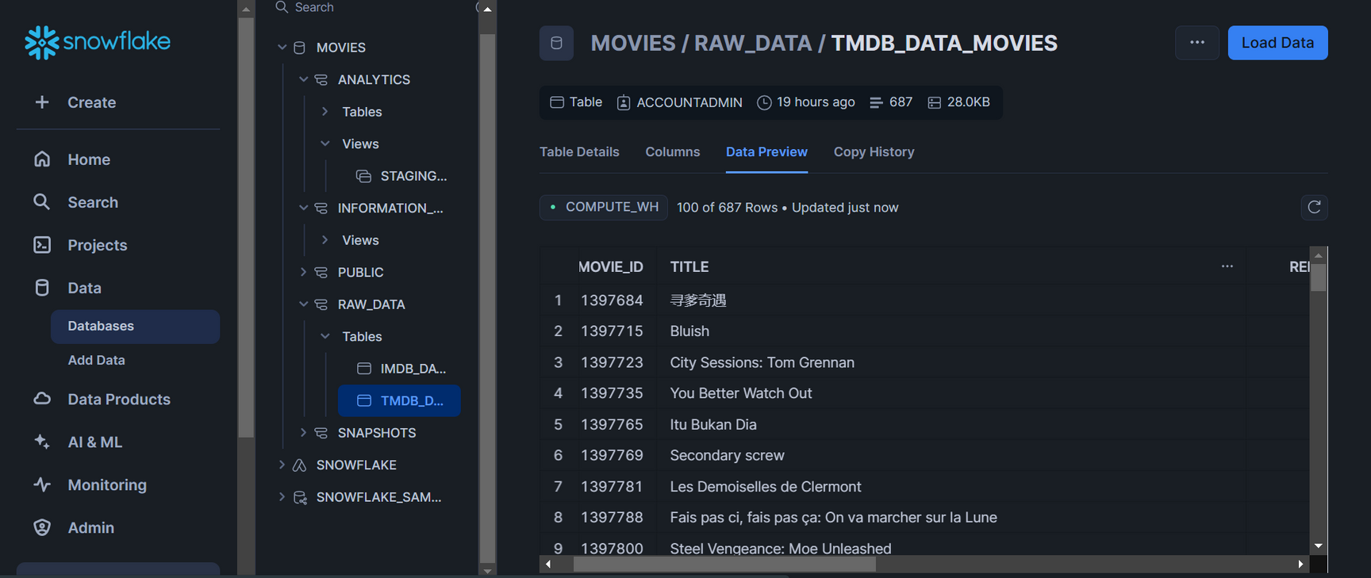
ETL/ELT PROCESS
Step 2 - Load
Load Raw Data from IMDb and TMDb directly into Snowflake

Slide 15
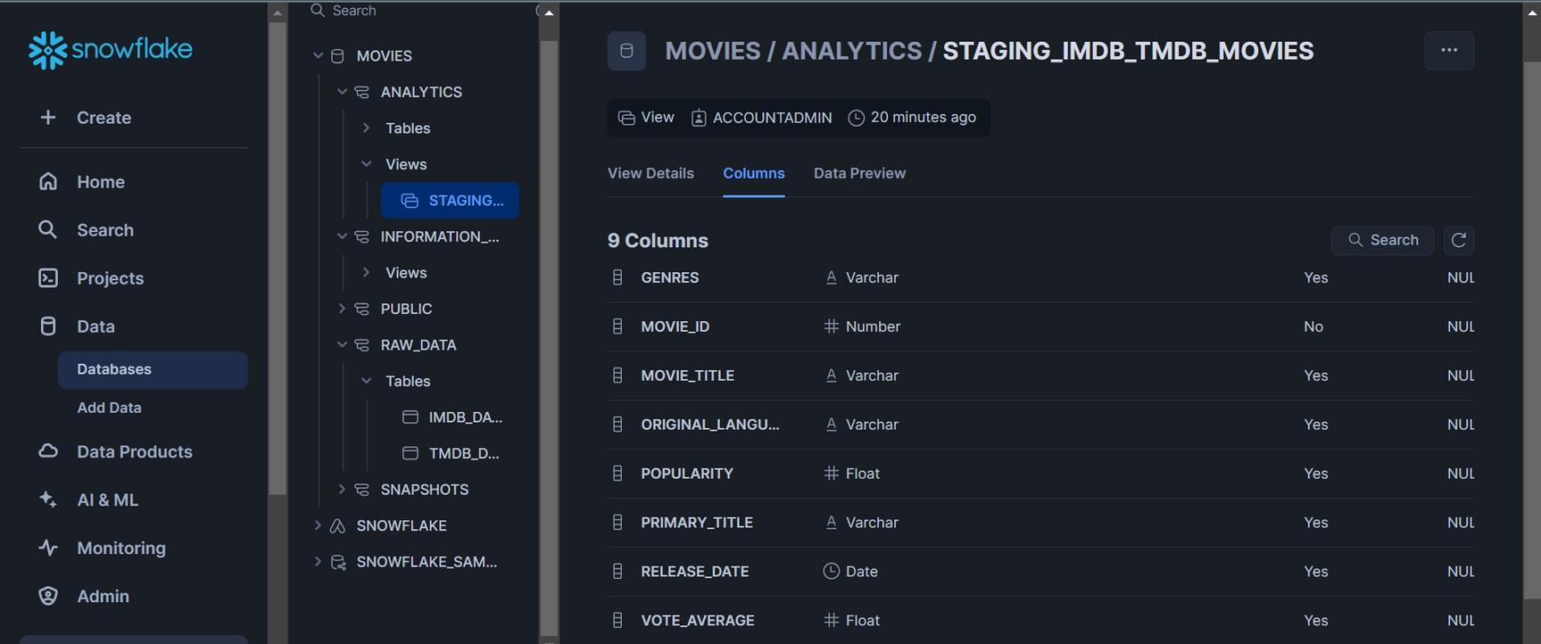
ETL/ELT PROCESS
Step 3 - Transform
Merged data from two sources using SQL transformations
Run dbt commands on transformed data

Slide 16
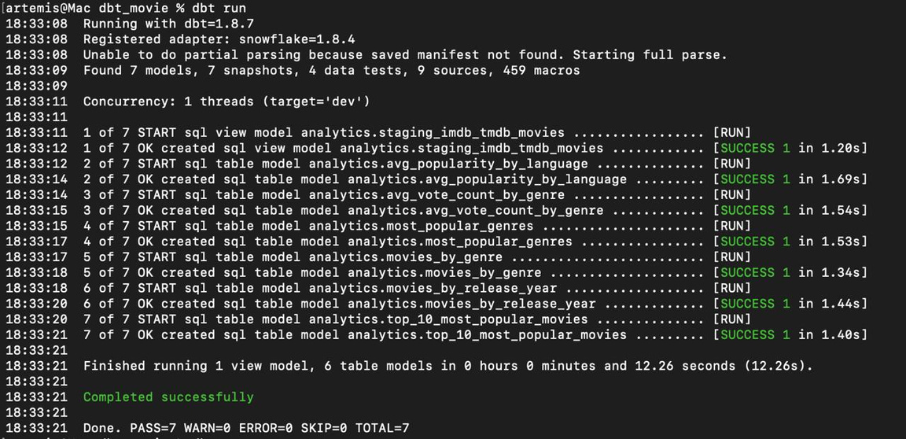
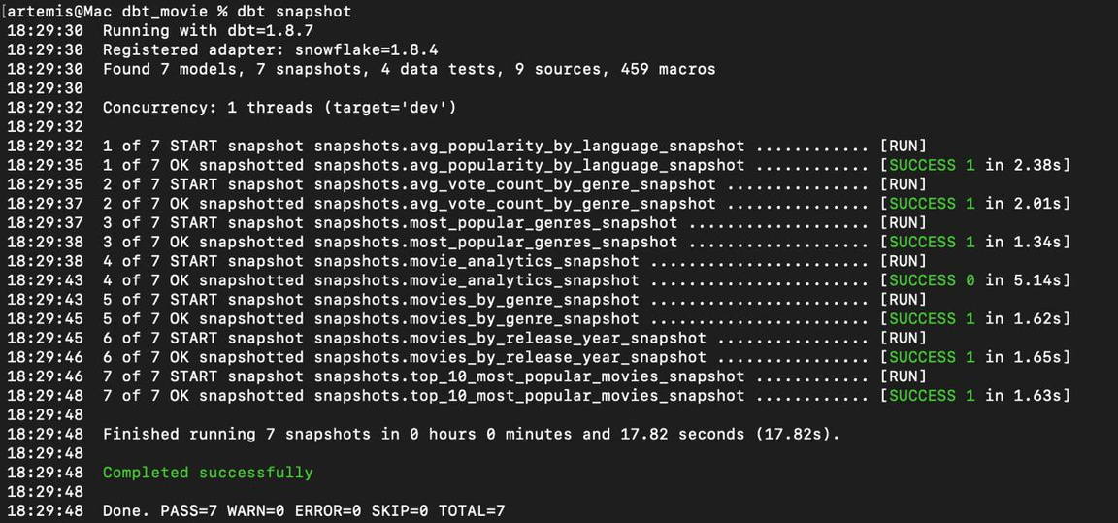
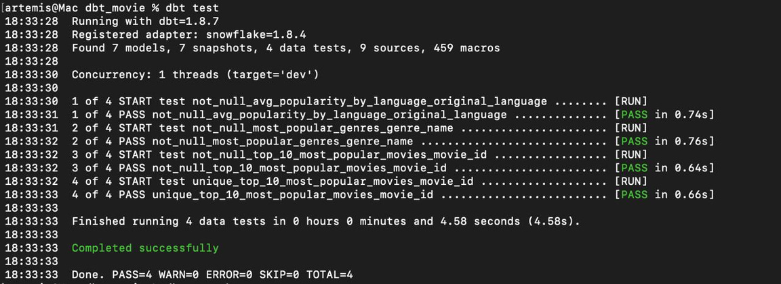
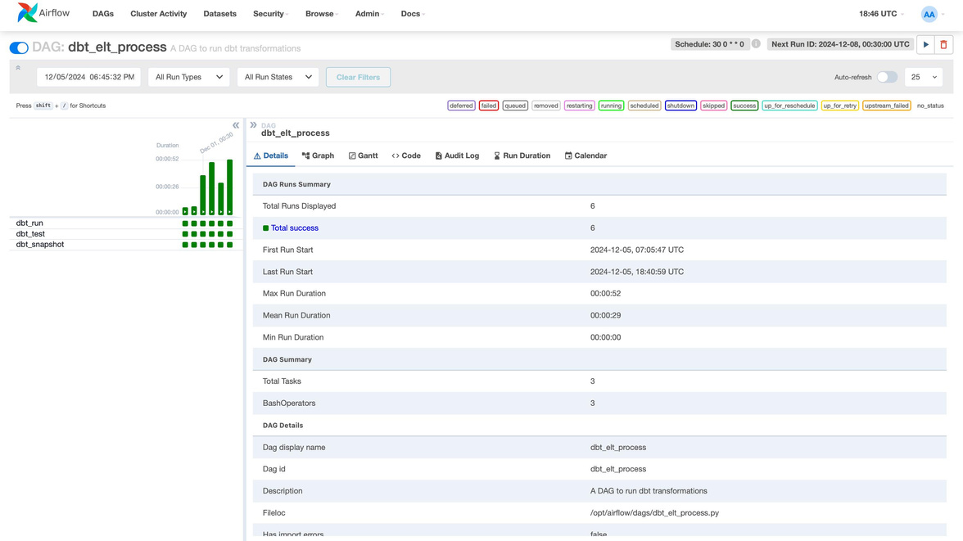
dbt run
dbt snapshot
dbt test
dbt dags in Airflow

Slide 17

VISUALIZATIONS

Slide 18
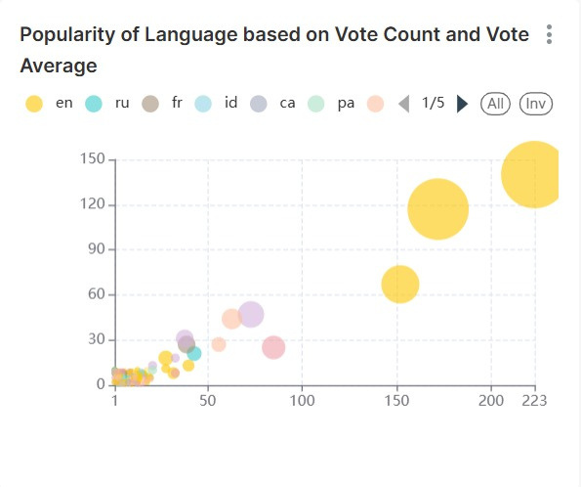
POPULARITY OF MOVIES
Notes:
Vote Count
Definition: The total number of individual votes or ratings a movie has received from users.
Purpose:
Indicates the popularity or level of audience engagement with the movie.
A higher vote count generally suggests that a movie has been widely viewed or discussed.
Vote Average
Definition: The average rating given to a movie based on all the votes it received. It's calculated as:
Vote Average = Sum of All Ratings/Vote Count
Purpose:
Reflects the quality or audience approval of a movie.
A higher average rating suggests that viewers generally liked the movie, while a lower rating implies mixed or negative reactions.

Slide 19
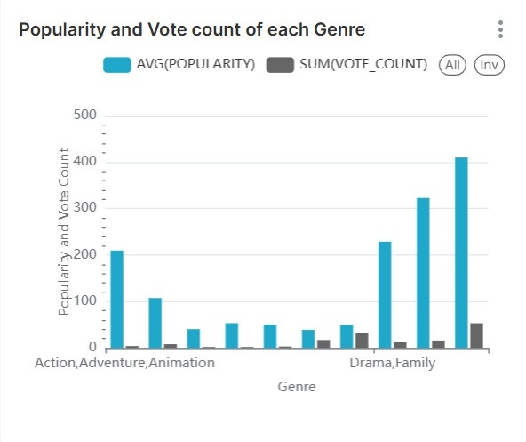
POPULARITY AND VOTE COUNT OF EACH GENRE

Slide 20
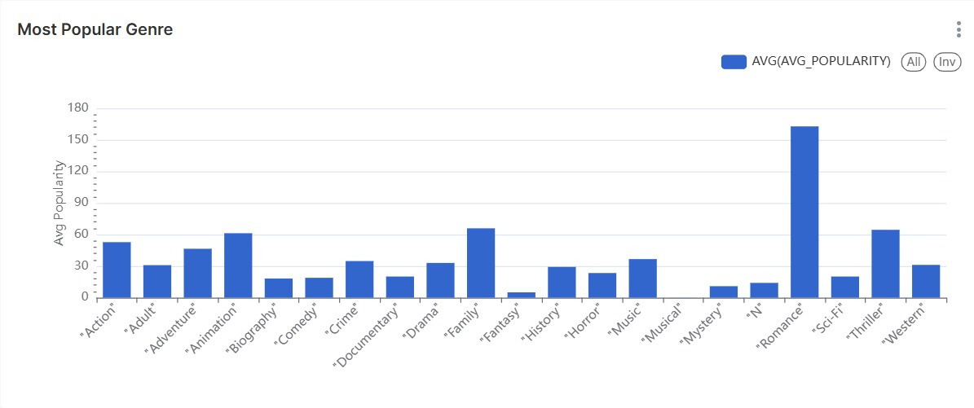
MOST POPULAR GENRE

Slide 21
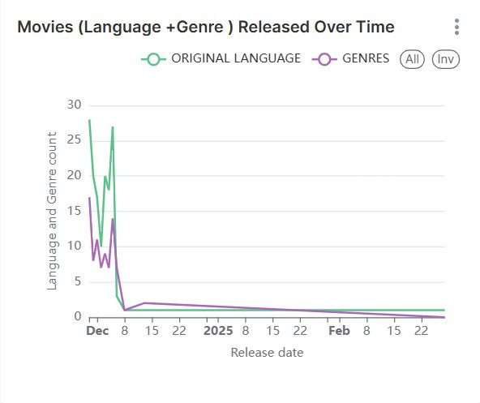
ANALYSINGMOVIES RELEASED OVER TIME BY THEIR LANGUAGE AND GENRE

Slide 22
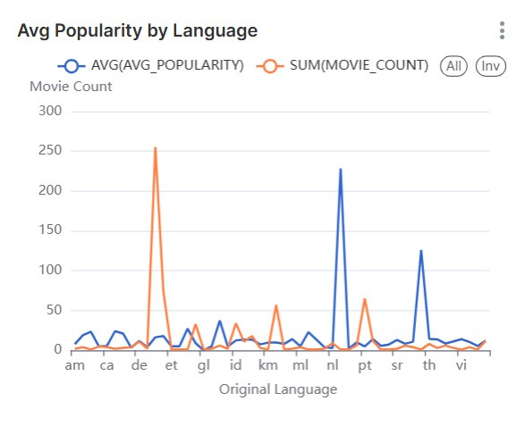
AVERAGE POPULARITY BY LANGUAGE

Slide 23

LINK TO LIVE DEMO

Slide 24

CONCLUSION
PROJECT SUMMARY:
BUILT AN EFFICIENT ETL/ELT PIPELINE TO INTEGRATE AND PROCESS MOVIE DATA FROM IMDB AND TMDB.
AUTOMATED EXTRACTION, LOADING, AND TRANSFORMATION OF DATA USING AIRFLOW AND DBT
FUTURE SCOPE:
EXTEND TO OTT PLATFORMS AND STREAMING ANALYTICS.
INCORPORATE SENTIMENT ANALYSIS FROM SOCIAL MEDIA REVIEWS.

Slide 25
THANK YOU!
GITHUB LINK FOR CODE

